Slide 1

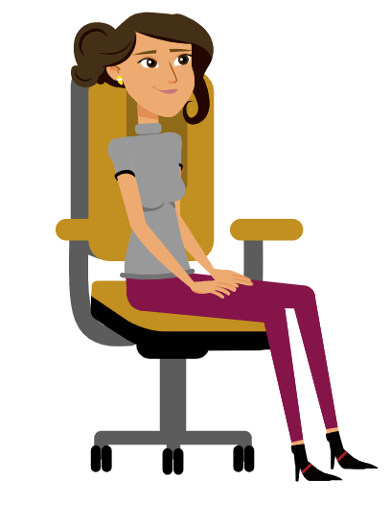
Wearable-based Activity Log Generation
(WALG)
Mohit Garg (705430435)
Rahul Garg (705429125)
Instructor: Prof. Mani Srivastava
Course: ECE M202A (Embedded Systems)
Walking
Sitting

Slide 2
Overall Project Goals and Specific Aims
With the ubiquitous presence of smart wearable devices around us, a huge amount of sensor data is generated on a daily basis.
In this project, we are aiming to use the sensor data retrieved from wearable devices to recognize and log the human activities.
We are using the IMU data (accelerometer, gyroscope) obtained from an Apple Watch worn by the user on their dominant hand.
The targeted human activities include daily activities like sitting, walking, eating, brushing, ascending and descending stairs etc.
The activities recognized will be logged and stored in a pdf document.

Slide 3
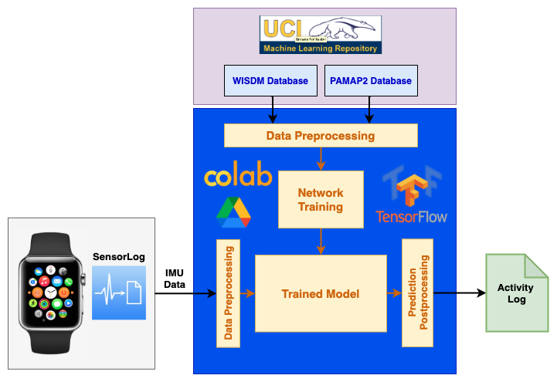
Technical Approach
Datasets
For training, we are using two different datasets - WISDM and PAMAP2. We are applying preprocessing to generate data windows that are fed to the model.
Platform
We are using Google Colaboratory for developing the models with tensorflow and Google Drive for storage.
Algorithms
We are trying different types of machine learning algos like CNNs, ConvLSTMs etc. to detect the human activity.
Data Collection The SensorLog app on Apple Watch is used to collect 6-DOF IMU data (accelerometer and gyroscope).

Slide 4
Current Status
Dataset Selection: After exploring a couple of datasets, we have decided to use WISDM and PAMAP2 because they are similar to our project goals (sensors and target activities).
Live Data Collection Setup: After experimenting with MotionSenseHRV and Apple Watch, we have chosen to use Apple Watch for live data collection because of multiple issues with the MotionSenseHRV wearable and the accompanying app.
Data Preprocessing: We have setup the data preprocessing flow to match the sampling frequency between training datasets and live data, sample the data using sliding windows and label these windows.
Exploring Network Topologies: We have implemented basic MLP and CNN models to get preliminary results on the training data.

Slide 5
Next Steps
Live Data Collection: Collect live data for training and testing the model.
Model Selection & Tuning: Compare different network topologies (like CNNs, LSTMs, ConvLSTMs etc) and perform hyperparameter tuning for improved accuracy.
Log Generation: Generate a log of the activities detected by the model.
Project Submission: Update project website, record a video demo and clean the github repository.

